Slide 1
But How is His Short Game?
A statistical criticism of conventional golf wisdom
By: Quinci Henry

Slide 2
Golf: A brief overview of ‘The Gentlemen’s Game’
A player has a bag of varying clubs with different weights and launch angles at his disposal.
The object is to hit the ball into the hole in as few swings, or ‘shots’, as possible.
Tradition holds that the shorter, higher lofted clubs, used for shorter shots as well as the ‘putter’, a club used to roll the ball, are a player’s ‘scoring clubs’

Slide 3
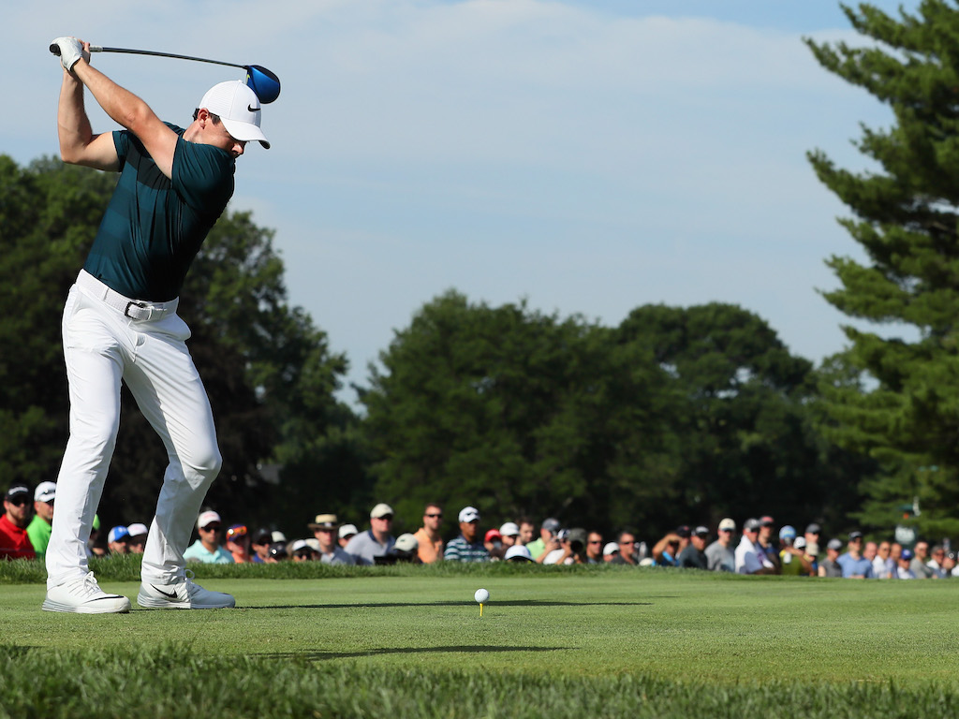

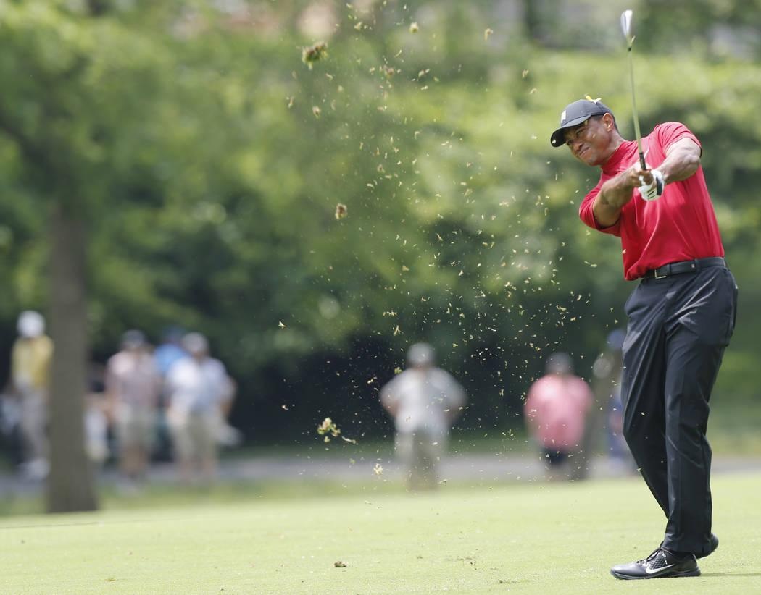

Shot types
Long
Short
Tee Shot
The player is so far away from the hole that he will likely not make the shot. The goal is to cover as much ground as possible with adequate accuracy.
Chip
The player now has the hole in sight and is trying to get himself in position to use his or putter.
Approach Shot
The player is now significantly closer to the hole but still has some ground to cover. More focus is still on distance but accuracy is more important than the tee shot.
Putt
The player now tries to roll the ball into the hole in as few attempts as possible.

Slide 4
The notions below are the catalysts for our examination
‘Drive for Show, Putt for Dough’
‘Practice the short game twice as much as the long game’
‘Big Hitters - The woods are full of them’
PGA players in 2019 were subset according to who is above average at which aspects of the game. We then used a statistical test to determine whether one group had lower overall scores than the other.
There were 100 players considered above average in the short game.
There were 116 players considered above average in the long game.

Slide 5
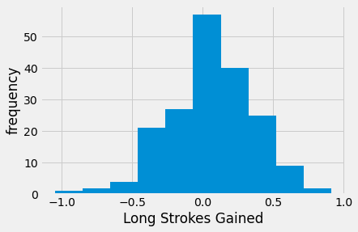
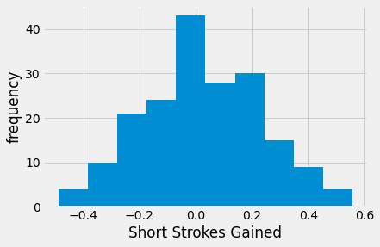
How the groups were determined: Shots Gained
Shots gained compares the magnitude of a players efficiency in relation to the average player. So 0 means a player is ‘average’ at that part of the game.

Slide 6
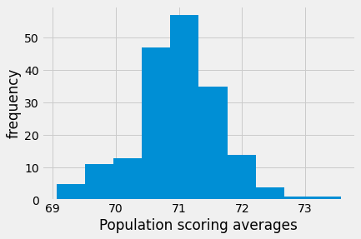
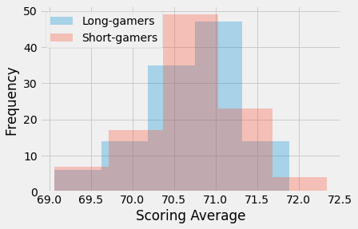
How the groups were judged: Overall scoring average
Average Scores for all Golfers
Average Scores by Group

Slide 7
Results
My stance was that the traditional wisdom holds and that the short game is actually more important.
To begin we started with the assumption that the average scores between the groups were equal.
The statistical test, known as Welch’s t-test, quite convincingly yielded that this notion cannot be rejected based on our data.
There was no evidence in the data to suggest that those who excelled in the short game fared better than those who excelled in the long game.

Slide 8
Reflection
It is possible that the short game is actually more difficult, tedious, and unintuitive to master, hence the obsession with teaching people to play golf a certain way.
I propose that perhaps it is more ‘accurate’ to say precision is more important holistically than power in golf.
Long game components: Power, Accuracy
Short game components: Accuracy
Perhaps people teach others to focus on the short game because they realize that improving accuracy and touch, in isolation, will permeate those skills into every aspect of the game.

